Slide 1
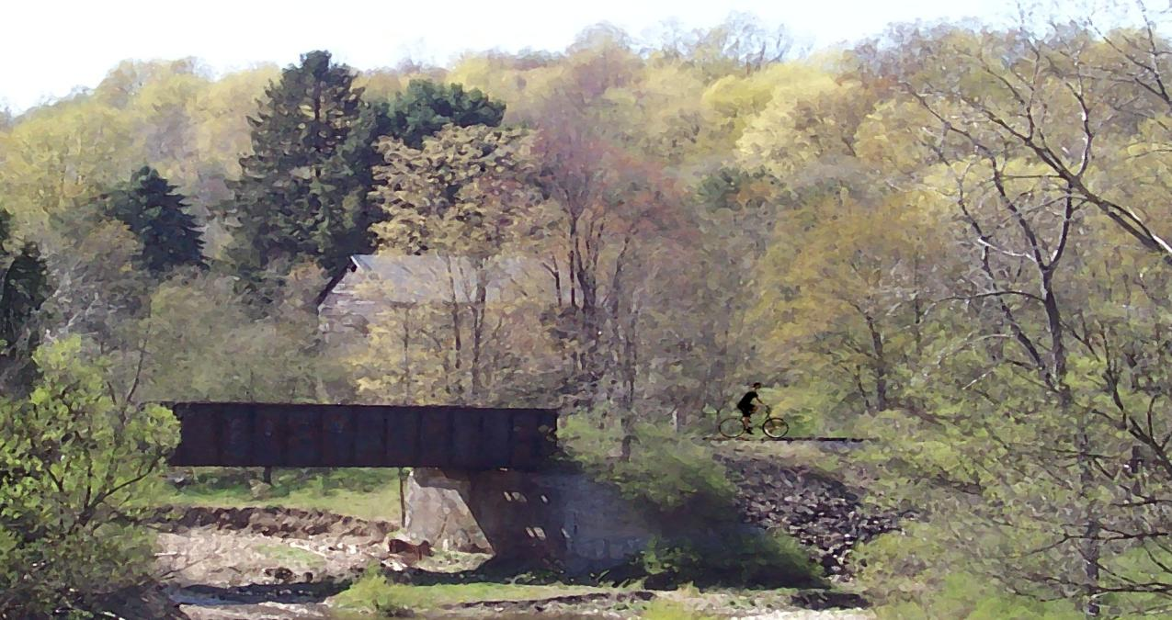
Benefits Of Greenways And Trails
Notes:
In the words of Theodor Roosevelt, our twenty-sixth US President:
“There is delight in the hardy life of the open. There are no words that can tell of the hidden spirit of the wilderness, that can reveal its mystery, its melancholy and its charm. The nation behaves well if it treats the natural resources as assets which must turn over to the next generation increased and not impaired value.” Theodore Roosevelt, twenty-sixth US President (1901-09) 1858-1919
And the words of Henry David Thoreau:
“When we walk, we naturally go to the fields and woods: what would become of us, if we walked only in a garden or a mall?” Henry David Thoreau, American writer and naturalist, 1838-1914
Source: NYS Parks and Conservation Association and The Business Council of NYS, Inc.
Photo: Bill Smith, 2008
Assembled by Anne Bergantz, 2008

Slide 2
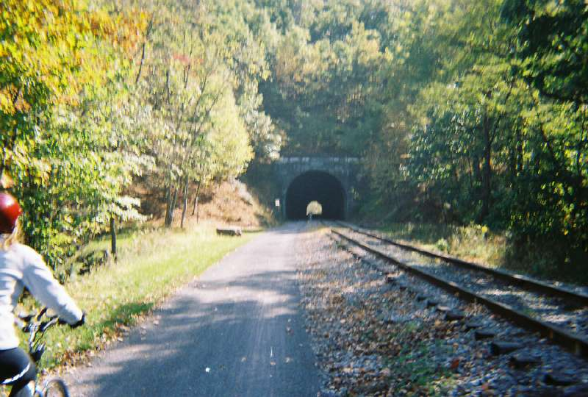
Benefits Of Greenways And Trails
What are rail-trails?
Rail-trails are abandoned rail
corridors that are converted
to public recreational use
through their purchase and/or
rail banking.
Notes:
Source: NYS Parks and Conservation Association and The Business Council of NYS, Inc.
Photo: Dave Ellis , 2007

Slide 3
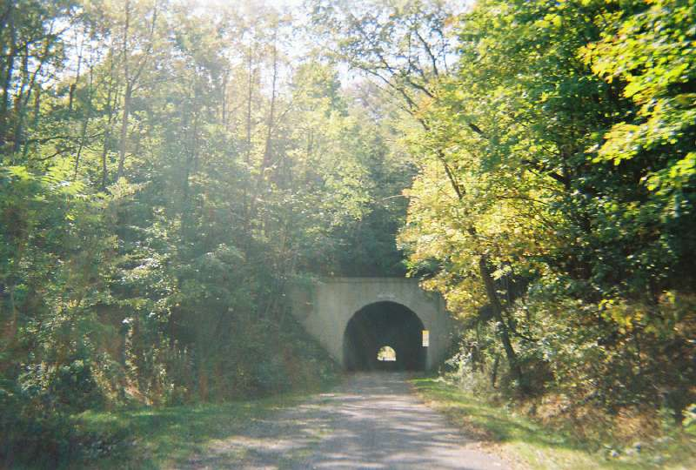
Benefits Of Greenways And Trails
What is rail-banking?
A voluntary agreement
between a rail carrier and
second party that preserves
the easements and rights of
way to the rail corridor for
future transportation use and
allows for current public
recreational trail use.
Notes:
Source: NYS Parks and Conservation Association and The Business Council of NYS, Inc.
Photo: Dave Ellis , 2007

Slide 4
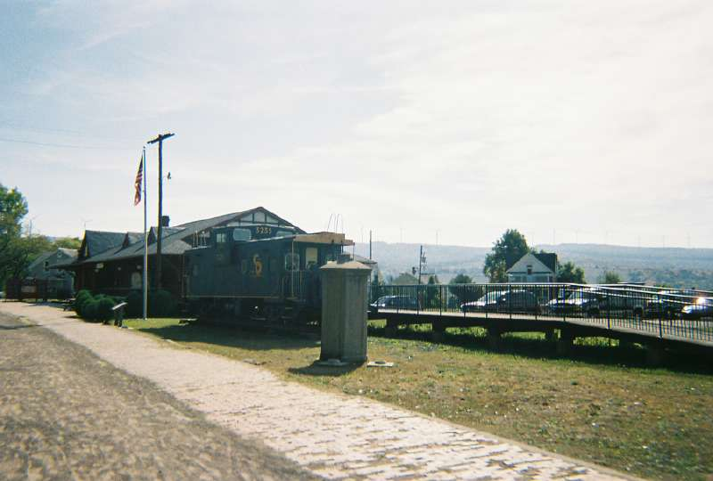
Benefits Of Greenways And Trails
Trails can
Boost local economies
Notes:
A major national parks service study of three rail-trails, an urban trail in California, a suburban trail in Florida and a rural trail in Iowa, found that trail use put between 1.2 and 1.9 million dollars into nearby communities each year.
Cape Cod Rail Trail Study of business owners adjacent to trail:
60% said trail is a prominent factor in their business expansion.
53% said revenue from trail users more than 10% of business
24% said the trail played a part in opening their business
Dunedin, Florida
1992 - 35% storefront vacancy rate
Converted CSX Railroad to “Pinellas Trail”
Now 100% store front occupancy with waiting list for available space
Wisconsin “Elroy-Sparta” State Park Trail,
32 mile trail
Hotel rooms booked one year in advance during peak season
Visitors average 228 miles travel to come to trail, that brings money to region
Katy Hiking and Biking Trail, Marthasville, Missouri
Yough River Trail, Connellsville, Pennsylvania
San Antonio River Walk, San Antonio, Texas
Stowe Recreation Path, Stowe, Vermont
Source: NYS Parks and Conservation Association and The Business Council of NYS, Inc.
Photo: Dave Ellis , 2007

Slide 5
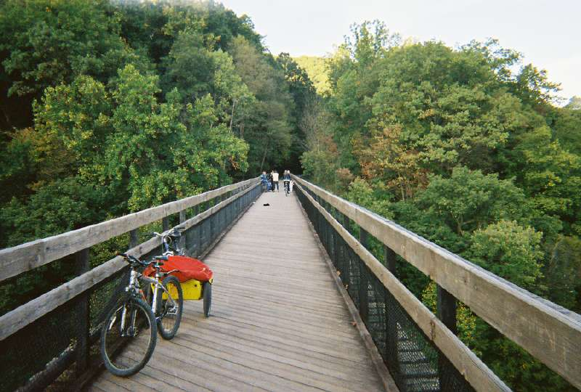
Benefits Of Greenways And Trails
Trails can
Boost local economies
Improve quality of life
Notes:
“Good recreational facilities are critical when recruiting employees” - James Pitt, Pres. and CEO of Cutco Cutlery Corp. an employer of 850 people.
Quality of Life is a crucial factor in recruiting and keeping good employees. That’s why three Olean NY corporations, Dexter, Cutco Cutlery and Dresser-Rand , contributed $10,000 apiece to complete the Allegheny River Valley Trail in South Western NY. The trail connects St Bonaventure University and the town of Allegany. It is so successful that they are looking to expand it.
Source: NYS Parks and Conservation Association and The Business Council of NYS, Inc.
Photo: Dave Ellis , 2007

Slide 6
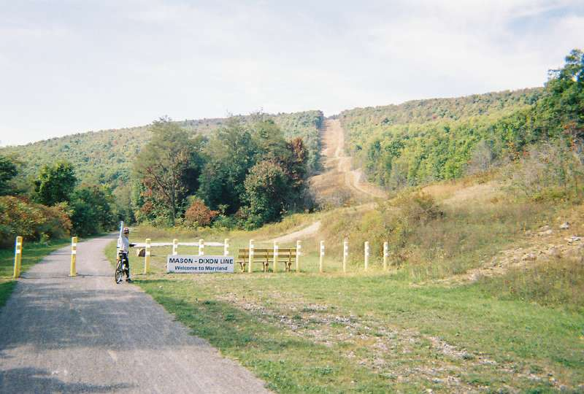
Benefits Of Greenways And Trails
Trails can
Boost local economies
Improve quality of life
Good for health
Notes:
Studies from the national Centers for Disease Control show that providing better access to places for physical activity increases the level of physical activity in a community. Becoming more active can help control weight, reduce high blood pressure, reduce risk of type 2 diabetes and heart attack, lessen symptoms of depression and anxiety, decrease arthritis and disability, prevent osteoporosis and falls.
Only 45% of men and 32% of woman engage in 30 minutes of daily moderate physical activity. As a consequence, more than half of New Yorkers are overweight or obese
More than $6 billion of NY’s Medicare and Medicaid costs are attributed to obesity.
Trails are an enjoyable, versatile and cost effective means of physical activity.
Seniors can benefit the most. As the least active age group in the US, regular physical activity can reduce the risk of chronic disease and disability.
Trails bring people closer to the natural world that can improve mental and physical health.
It is easier to keep fit when there is easy access to recreation close to home.
The report “Physical Inactivity in NYS, an economic cost analysis”, estimates that inactivity costs NYS $3 billion per year.
In addition, universal access trails provide people with disabilities access to otherwise inaccessible natural areas.
Source: NYS Parks and Conservation Association and The Business Council of NYS, Inc.
Photo: Dave Ellis , 2007

Slide 7
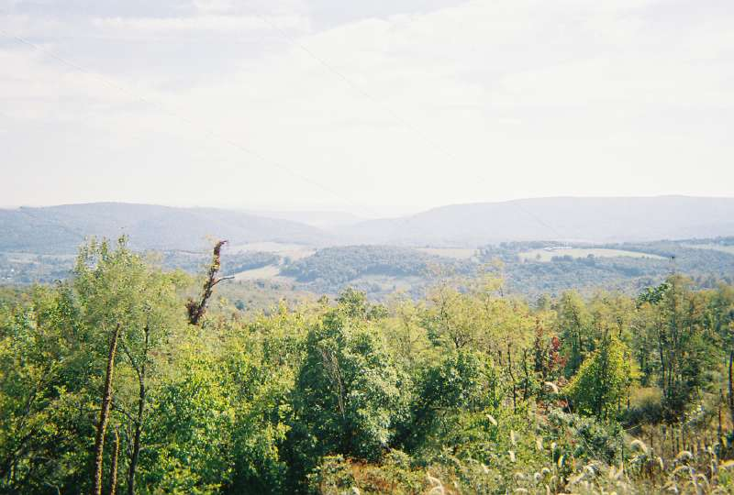
Benefits Of Greenways And Trails
Trails can
Boost local economies
Improve quality of life
Good for health
Good for environment
Notes:
Protects open space and preserve critical wildlife corridors.
Protecting corridors can help control flooding, protect water quality and fragile stream ecosystems.
Source: NYS Parks and Conservation Association and The Business Council of NYS, Inc.
Photo: Dave Ellis , 2007

Slide 8
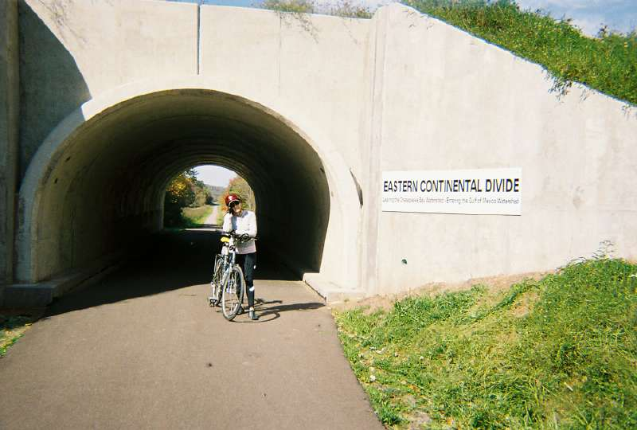
Benefits Of Greenways And Trails
Trails can
Boost local economies
Improve quality of life
Good for health
Good for environment
Better way to get around
Notes:
A growing number of people are walking and biking to work and other destinations.
That number would increase if there was safe and accessible trails to use.
Louis Harris Poll determined that 1/2 of all Americans would be willing to ride a bike to work if they could bike on separate, safe pathways. With the current rising cost of auto fuel, that number is probably higher.
Source: NYS Parks and Conservation Association and The Business Council of NYS, Inc.
Photo: Dave Ellis , 2007

Slide 9
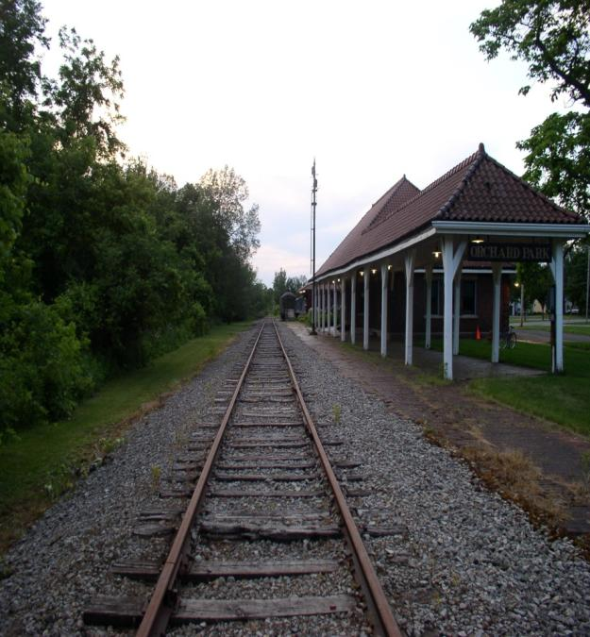
Benefits Of Greenways And Trails
Trails can
Boost local economies
Improve quality of life
Good for health
Good for environment
Better way to get around
Preserve historic heritage
Notes:
The NY railroads played an important part in the development of NYS.
They facilitated trade and westward expansion.
Preserving railways corridors offers future generations the chance to experience and learn about NY history.
Cultural tourism is the fastest growing segment of the tourist industry.
Source: NYS Parks and Conservation Association and The Business Council of NYS, Inc.
Photo: Dave Ellis , 2007

Slide 10
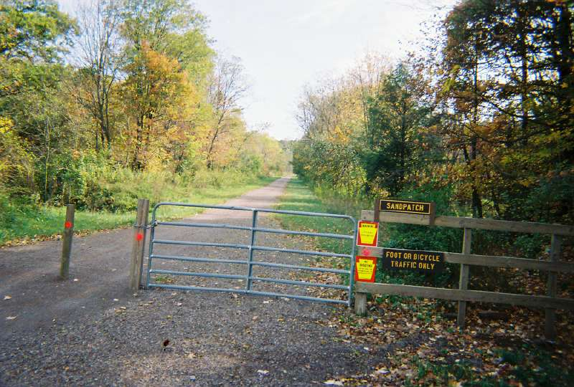
Benefits Of Greenways And Trails
Trails can
Boost local economies
Improve quality of life
Good for health
Good for environment
Better way to get around
Preserve historic heritage
Enhance civic engagement
Notes:
In the words of Anne Lusk, Stowe Vermont greenway advocate:
“People are different on a path. On a town sidewalk strangers may make eye contact but that is all. On a path they smile, say hello and pet one another’s dogs. I think every community in America should have a greenway.”
Source: Parks and Trails New York and The Greenway Conservancy for the Hudson River Valley.
Photo: Dave Ellis , 2007

Slide 11
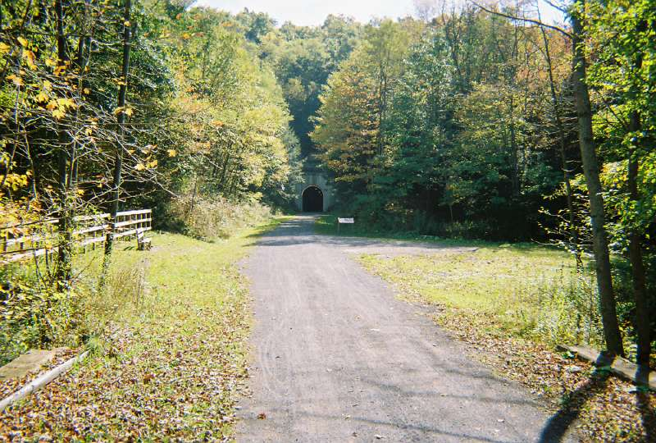
Benefits Of Greenways And Trails
A growing movement
2000
  65 trails in NY State
  700 miles statewide
2008
  101 rail-trails in NYS
  1151 miles statewide
Notes:
Nationally, Rails to Trails Conservancy estimates Americans use rail-trails close to 100 million times a year for recreation, transportation and health.
Source: Rails to Trails Conservancy, 2008; NYS Parks and Conservation Association and The Business Council of NYS, Inc., 2000
Photo: Dave Ellis , 2007

Slide 12
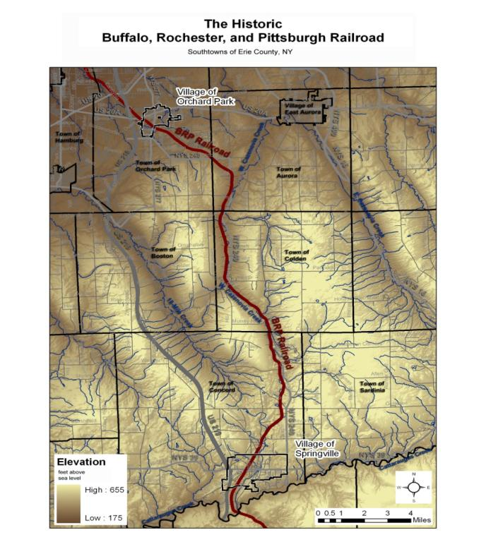
Erie-Cattaraugus Rail-Trail
Buffalo-Pittsburgh Rail Corridor
30 miles between mile 9 in Orchard Park and and mile 39 in West Valley.
Links the Village of Orchard park to the Village of Springville through the towns of Orchard Park, Aurora, Colden, Concord and Ashford.
Notes:
A rail-trail between Johnstown and Gloversville in Fulton, County NY converted a 2.8 mile litter strewn section of abandoned railway to the pride of two communities.
They hope to expand it another 14 miles.
“Pick any nice day and you’ll find wall to wall people along the trail. There is a special feeling among the people, too. People who wouldn’t ordinarily speak to each other are chatting away”
We’ve had tremendous buy-in from the community. People volunteer to clear the trail, police it and even make benches for it.”
Lisa McCoy, president of their 775 member chamber of commerce
Source: Federal Surface Transportation Board, 1998 Buffalo-Pittsburgh application to abandon
NYS Parks and Conservation Association and The Business Council of NYS, Inc.
Map: Bill Smith, 2008

Slide 13
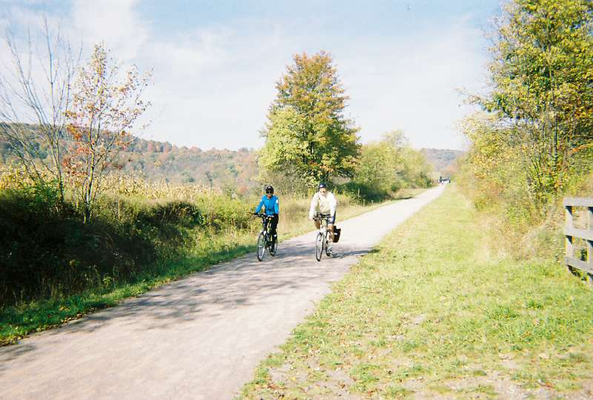
Common Landowner Concerns
Trails make good neighbors
Notes:
Property owners adjacent to trails may agree with the trail concept but are concerned about liability, litter, vandalism, privacy and other trail maintenance concerns. Studies of the many trail systems throughout the country show that these are more perceived than actual problems. Nevertheless, trail organizations must commit to plan, build and manage trails to minimize potential issues.
Source: Greenway Conservancy of the Hudson River Valley and Parks and Trails New York. 2002
Photo: Dave Ellis, 2007

Slide 14
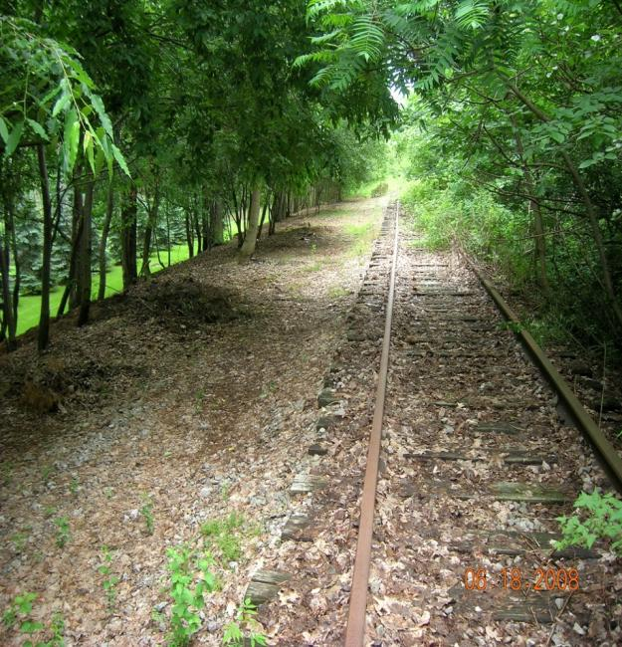
Common Landowner Concerns
Liability
  What if someone gets hurt?
  Can I be sued?
  Does my insurance cover this?
Notes:
New York’s Recreational Use Statute limits the liability of landowners who voluntarily allow access to their land for recreational activities such as hiking, biking, x-country skiing and horseback riding. This statute provides landowners with important protections.
The law applies whether or not the landowner grants permission for use as long as they do not charge a fee and do not maliciously fail to guard against hazards.
In addition, homeowner insurance protects the property owner if someone is injured on their property whether they have permission to be there or not.
The combination of recreational use statute and homeowner insurance provide a solid shield against the risk of litigation.
In addition the local trail organization should have liability or self insurance and may be able to include property owners as additionally insured. A lawyer should be consulted for more detailed information and current state law.
Source: Greenway Conservancy of the Hudson River Valley and Parks and Trails New York. 2002
Photo: Peter Swartwout, 2008

Slide 15
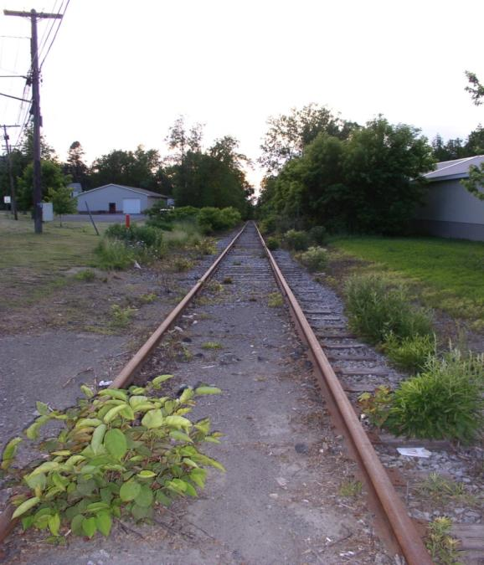
Common Landowner Concerns
Safety
  Will trails bring Crime?
Notes:
Abandoned and neglected property invites crime. Places where there is activity, attention and interest have less crime. In the words of author and urbanist Jane Jacobs, the safest places are where there are “eyes on the street”.
Trails have excellent safety records. Four separate studies, conducted between 1979 and 1997, concluded that landowners adjacent to trails experienced negligible crime as a result of trails.
A 1998 study of 372 rail-trails nationwide, totaling more than 7,000 miles of trails and over 45 million users, found that trails are among the safest places in communities.
A study of the 1800 mile Appalachian Trail found that a trail user would be more likely hit by lightning than a victim of crime on the trail.
Source: Greenway Conservancy of the Hudson River Valley and Parks and Trails New York. 2002
Photo: A. Bergantz, 2008

Slide 16
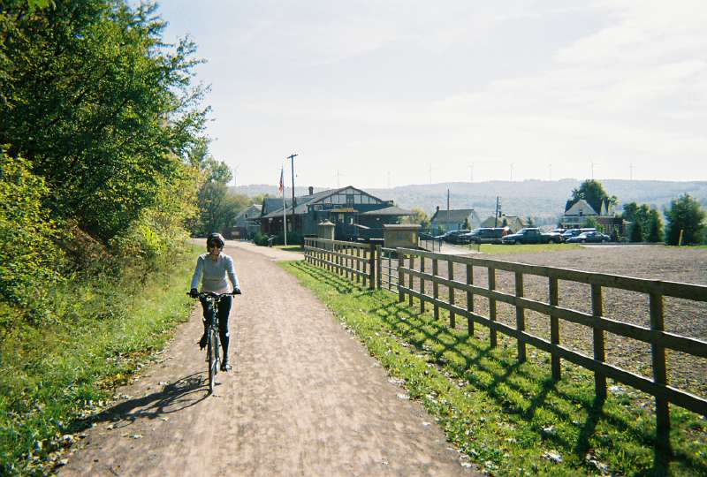
Common Landowner Concerns
Privacy and Trespassing
  Will trail users enter my property?
Notes:
Trail use is a directed through activity. Trail users tend to stay on the path and not loiter or enter adjacent property.
Trail organizations work with property owners to minimize the impact of trail activity. Natural barriers, topography, landscaping and fencing can help buffer private property from trail activity.
Education of trail users and signage along the trail corridor help users to respect private property, understand trail use is a privilege and they have a responsibility for personal stewardship.
Source: Greenway Conservancy of the Hudson River Valley and Parks and Trails New York. 2002
Photo: Dave Ellis, 2007

Slide 17
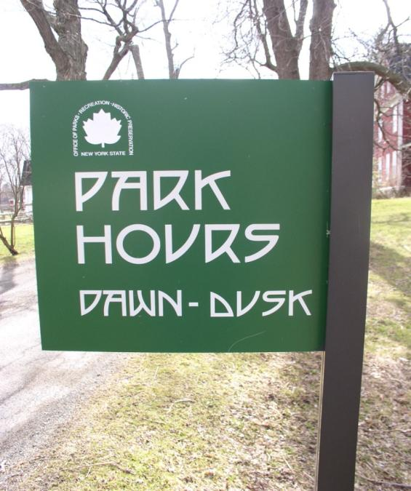
Common Landowner Concerns
Litter and Vandalism
  Will trail users leave a mess behind?
Notes:
Trails users tend to be interested in preserving the natural beauty of the environment.
Signs, such as “carry in-carry out”, maintenance and monitoring by your local trail organization and volunteers help promote well kept trails.
Source: Greenway Conservancy of the Hudson River Valley and Parks and Trails New York. 2002
Photo: A. Bergantz, 2007

Slide 18
Common Landowner Concerns
Maintaining traditional Land uses
  Can traditional activities like hunting, trapping, logging and agriculture continue?
Notes:
Local trail partners are encouraged to maintain and foster traditional land uses. Trails can be compatible with traditional uses such as agriculture, forestry, and hunting. A major focus of trail development is the natural, cultural and historical preservation of the area.
Source: Greenway Conservancy of the Hudson River Valley and Parks and Trails New York. 2002
Photo: Dave Ellis, 2007

Slide 19
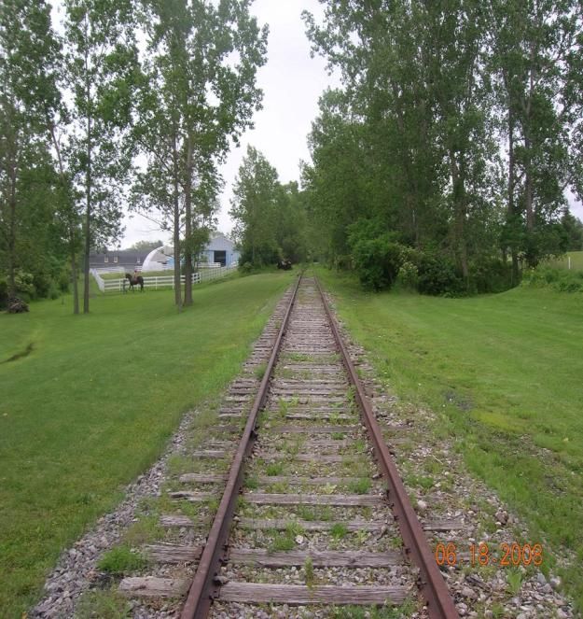
Common Landowner Concerns
Property Values
  What will a trail do to my property value?
Notes:
The impact of a trail on property value is a common landowner concern. National studies indicate that property values typically increase slightly or remain the same.
1993 River and Trails Program study by Pennsylvania State University that included 663 property owners and 71 realtors, concluded that trails do not have an adverse effect on property values.
Similar studies of the adjacent landowners along the Mohawk-Hudson Bike-Hike trail in 1998 and a 1997 Minnesota study of the Minneapolis/St Paul trails concluded the same. Trails increase or have no effect on their property value.
A 1997 survey concluded that one third of all residents along the Iron Horse Trail in Contra Costa California bought their homes because of the trail and for other residents it was not a positive or negative factor in their home purchase.
According to a 2001 study by Cornell University, proximity to parks and recreation is among the top five reasons people give for selecting a community to live in.
Source: Greenway Conservancy of the Hudson River Valley and Parks and Trails New York. 2002
Photo: Peter Swartwout, 2007

Slide 20
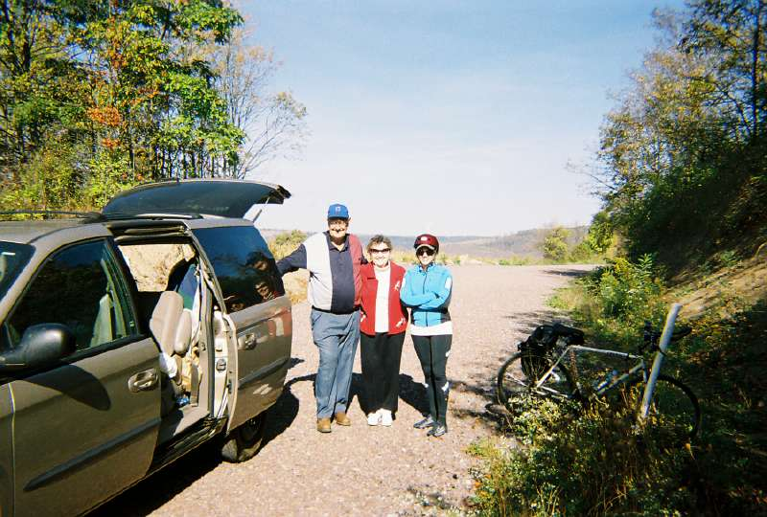
Common Landowner Concerns
Management Responsibilities
  Will I have a voice?
Notes:
Landowners can be active participants in all management decisions. Local trail organizations work closely with adjacent landowners to develop management and maintenance plans for each section of the trail that meet their needs and interests.
Source: Greenway Conservancy of the Hudson River Valley and Parks and Trails New York. 2002
Photo: Dave Ellis, 2007

Slide 21
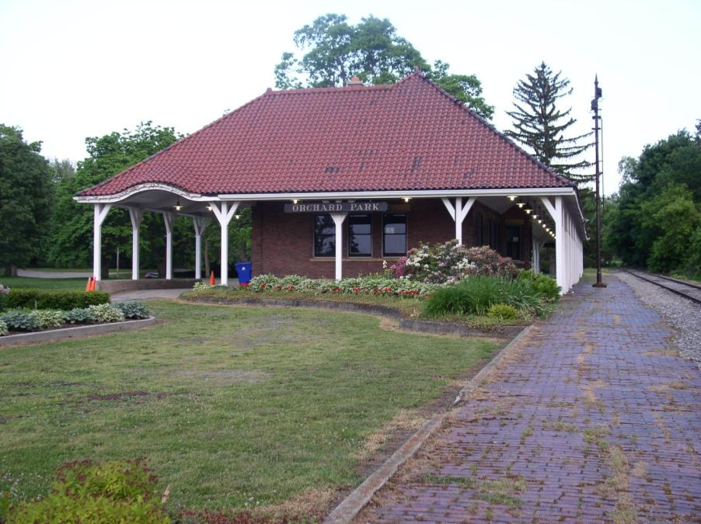
Erie-Cattaraugus Rail-Trail
Notes:
B-P Depot, Village of Orchard Park
Photo: A. Bergantz, 2008

Slide 22
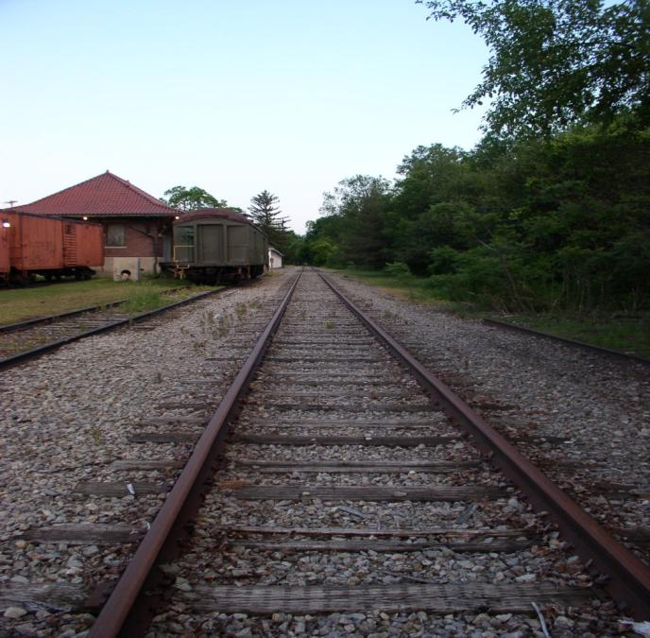
Erie-Cattaraugus Rail-Trail
Notes:
Village of Orchard Park
Photo: A. Bergantz, 2008

Slide 23
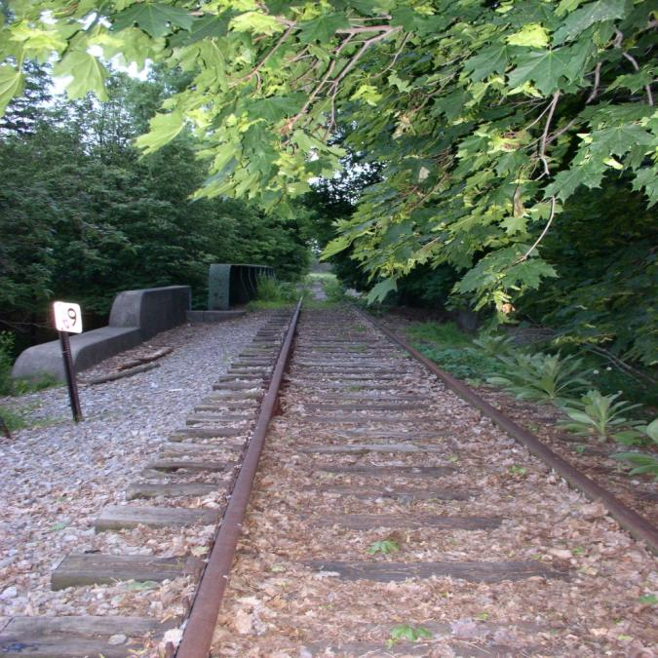
Erie-Cattaraugus Rail-Trail
Notes:
Mile nine marker, Orchard Park
Photo: A. Bergantz, 2008

Slide 24
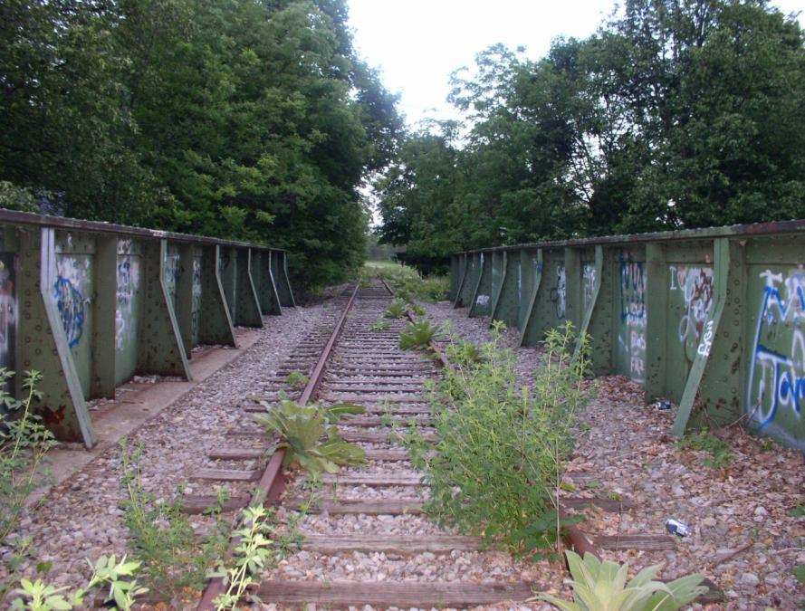
Erie-Cattaraugus Rail-Trail
Notes:
Rail bridge over 240, Orchard Park
Photo: A. Bergantz, 2008

Slide 25
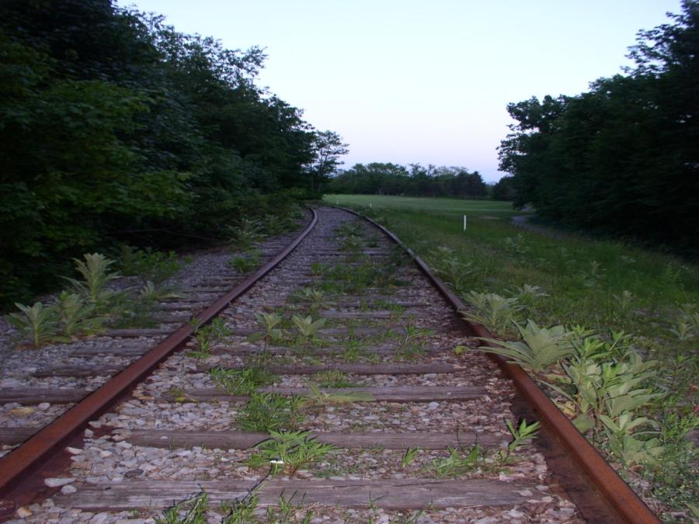
Erie-Cattaraugus Rail-Trail
Notes:
Orchard Park
Photo: A. Bergantz, 2008

Slide 26
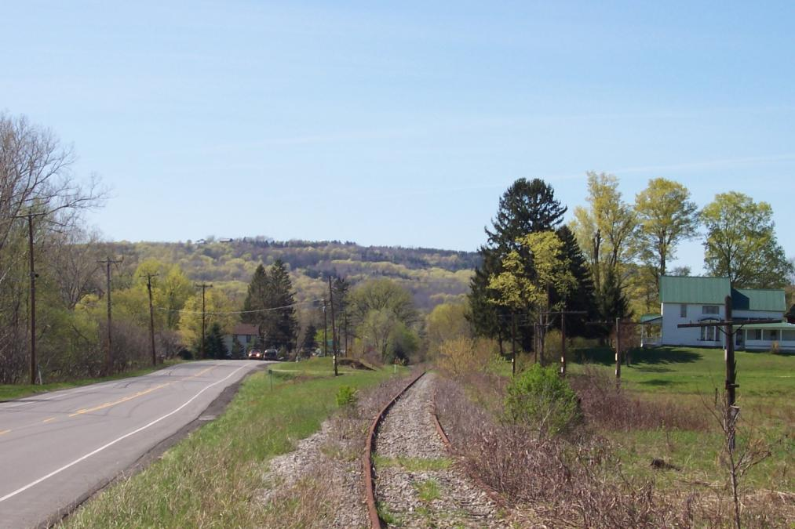
Erie-Cattaraugus Rail-Trail
Notes:
Route 240, Colden
Photo: Bill Smith, 2008

Slide 27
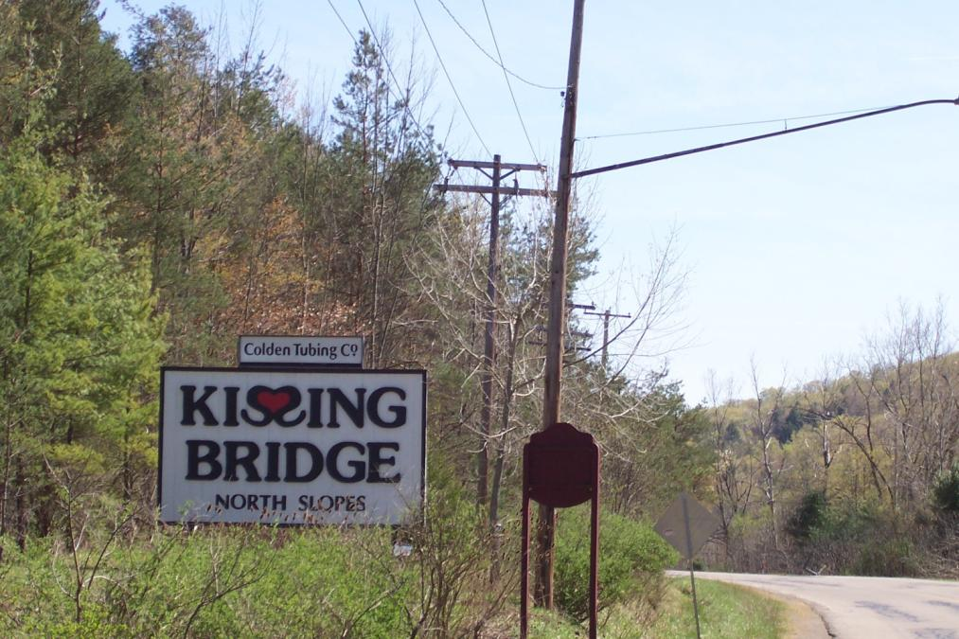
Erie-Cattaraugus Rail-Trail
Notes:
Kissing Bridge Ski Resort, Colden
Photo: Bill Smith, 2008

Slide 28
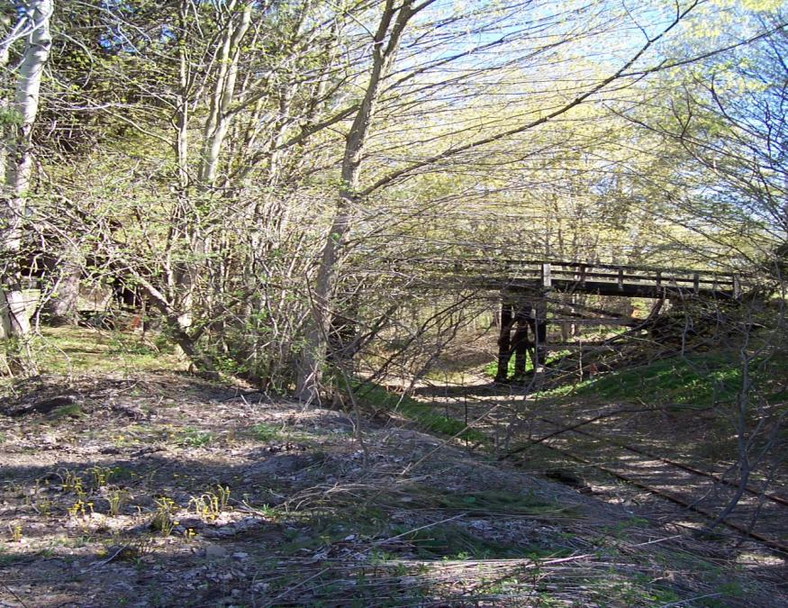
Erie-Cattaraugus Rail-Trail
Notes:
Buffalo-Pittsburgh rail corridor
Photo: Bill Smith, 2008

Slide 29
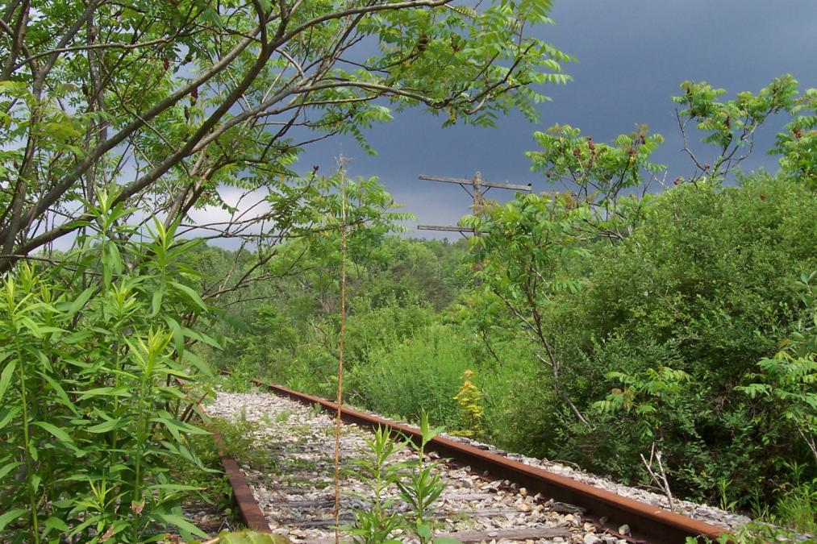
Erie-Cattaraugus Rail-Trail
Notes:
Buffalo-Pittsburgh rail corridor
Photo: Bill Smith, 2008

Slide 30
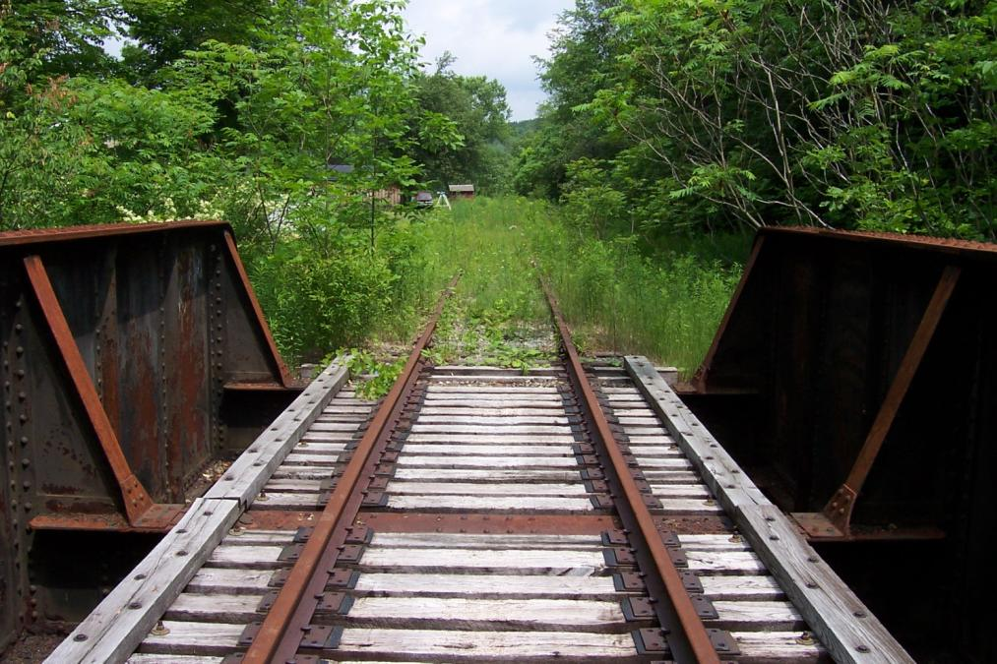
Erie-Cattaraugus Rail-Trail
Notes:
Buffalo-Pittsburgh rail corridor
Photo: Bill Smith, 2008

Slide 31
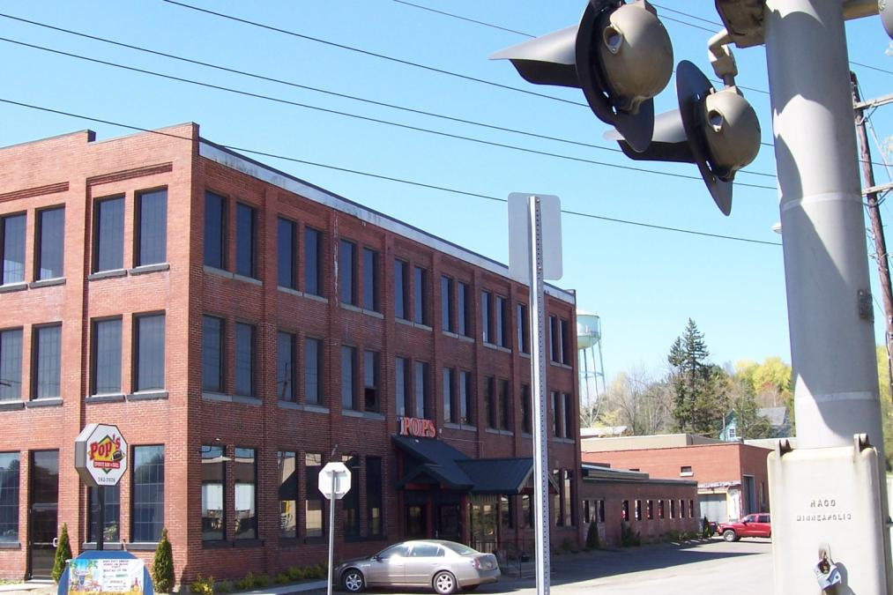
Erie-Cattaraugus Rail-Trail
Notes:
Glenn “Pop” Warner Museum, Concord Historical Society, Village of Springville
Photo: Bill Smith, 2008

Slide 32
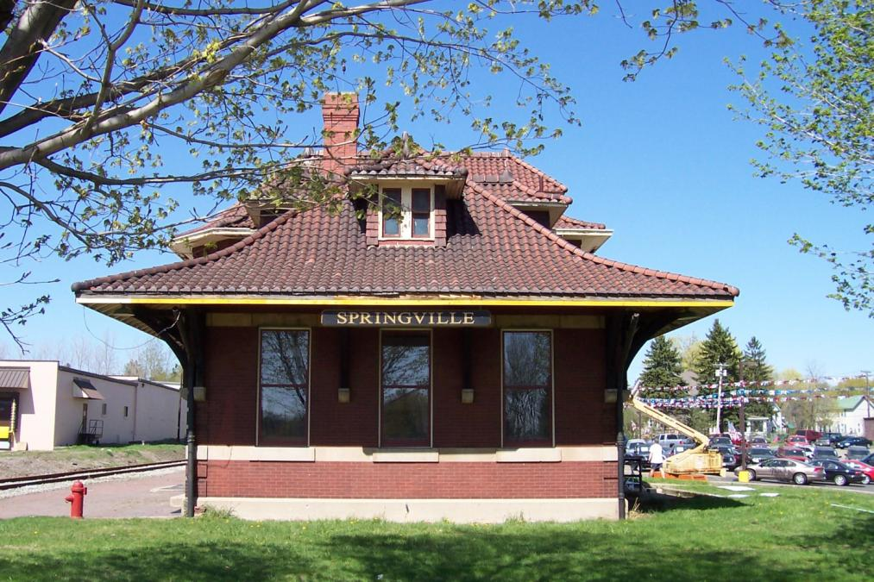
Erie-Cattaraugus Rail-Trail
Notes:
B-P Depot, Village of Springville
Source: Bill Smith, 2008

Slide 33
Erie-Cattaraugus Rail-Trail
Notes:
“Successful greenways grow out of the grassroots. They depend on local enthusiasm, local money, local leaders, local priorities, local agreements and local governments. They depend on highly motivated volunteers including individuals, groups and businesses. They are dependent, in short, on a strong sense of community responsibility and on the willingness of each community to link its destiny to that of its neighbors.” David Burwell, President, Rails-to-Trails Conservancy, 1996
Source: NYS Parks and Conservation Association and The Business Council of NYS, Inc.

